Slide 1
Energy Efficiency in <insert community>
Presentation to Chief and Council
<Insert community photo or logo>
A joint initiative brought to you by:
Ministry of Energy and Mines
BC Hydro
Developed and delivered by:
Quality Program Services
Notes:
Introduction of presenters.
Welcome the community and elders.
Thank you for the welcome into their space.
Explain why you’re here.

Slide 2
Introduction and Outline
Why energy use should matter to you!
Benefits of reducing energy use
Funding and business case analysis
Energy efficiency policy and procedures
How-to: implementation of energy policy
Creating community-driven initiatives
Notes:
Go over the outline of what will be covered in this presentation.

Slide 3

Why it Matters
How energy use impacts Council’s role:
  Budget
    Lifespan of homes, maintenance costs
  Physical and financial health of residents
  Funding opportunities
    Energy efficiency upgrades and education
  Protect the land
Energy use is on the rise in BC, and our intent
is to decrease energy consumption to take
pressure off the system as a whole
Notes:
Incorporating energy efficiency practices and a larger program impacts Chief and Council by:
-budgetary allowance for maintenance and renovations and opportunity for long-term savings which could be used for other priorities in the community, housing stock value, materials and installation cost savings when higher quality (and energy efficient products) are used
-home comfort (we all want to be warm and comfortable in our homes) and resident’s health and safety (drafts and mould can make us uncomfortable or sick)
-significant funding opportunities exist through a number of bodies for energy efficiency projects
-your land (how power generation and use can impact the environment)

Slide 4
General Energy Information
The energy supply in <insert community> comes from:
Natural gas
  Typically found above petroleum resources
Propane
  Byproduct of natural gas processing and petroleum refining
Electricity
  Hydroelectricity and/or diesel generation in remote communities
Wood
  Locally sourced and used
Notes:
Give context about the impacts of the energy use applicable to this community (e.g. electricity and natural gas primarily).

Slide 5
<Insert community> -specific Energy Information
Housing types and age
# Homes: rental vs owned
Estimated cost of electricity/fuel paid for by the nation
Current programs or initiatives regarding housing and organizational structure
Short and long term outlook for housing: new construction and upgrades
Notes:
Explain (based on previous investigation/data gathering) or ask the community about their current energy efficiency situation, including:
Most common types and ages of housing in the community
How much the community is paying for electricity (all types) as a whole or as individual homeowners
Existing programs and initiatives shaping community housing and home energy usage/ energy efficiency
Challenges being faced by different groups in the community (budgetary, maintenance, living situation, etc.)

Slide 6

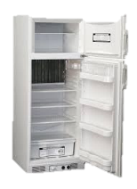



Where are your energy dollars going?
A Breakdown of Average Canadian Home Energy Use
When Total Energy Bill is $2,000 a year
Notes:
The average Canadian spends about $2000 per year on electricity.
*this data is from a few years ago, so the number may be a bit higher now.
When we look at where this energy is being used, we can see that 60 percent of it ($1,200) is going to Space Heating.
Another 20 percent is going to Water Heating.
Appliances (refrigerators, televisions), lighting and cooling make up the rest, but they are a much smaller portion.

Slide 7
First Nation Energy Use and Cost can be Double*
When Total Energy Bill is $4,000 a year
*No statistical data available – based on anecdotal experience
Notes:
Anecdotal evidence suggests that energy costs for First Nations communities can be double, or more, the costs for the average Canadian household.
This means many First Nations households can easily be spending $4,000/year on energy (primarily a combination of electricity and gas costs).
In these cases, that means that 80%, or $3,120 of those energy dollars, are going to space and water heating alone!
So if you want to lower your bills, where should you focus your efforts?
Changing lightbulbs isn’t a bad idea, but prioritizing improvement to heating and keeping heat in (i.e., draftproofing) is where you can make the biggest impact.

Slide 8
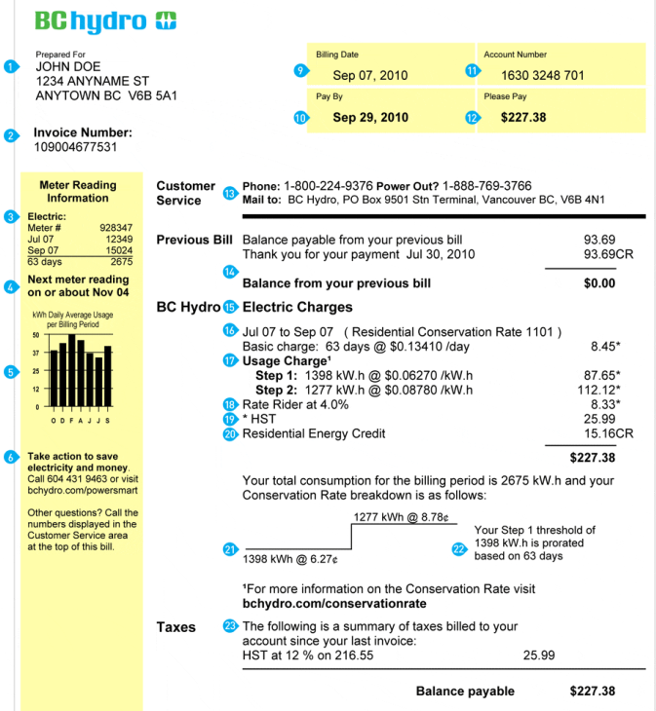

Understanding Your Energy Bill
Notes:
There is a lot of information on your energy bills, but if you’re only going to take note of a couple different parts, take note of these ones:
Hydro:
Your Hydro rates are stepped. That means that usage up to a certain amount is charged at $0.XX [use rates for this community], and anything you use beyond that number of kWhs is charged at a higher rate. If possible, it’s best to try to stay below the threshold where you jump up to the higher rate. You might not notice this in your bills (if you have equal payment billing, for example), but you will be paying for it in the end.
Fortis:
On the side of your Hydro bill and also on your Fortis bill, there is a little bar chart that shows your usage over the year. Take a look at this and see where there are fluctuations. If you live in a place where you don’t use space heating in summer months, the levels you’re using in summer months are mostly how much you’re using to heat water and power appliances.

Slide 9

Notes:
[Only for communities with Smart Meters]
BC Hydro has a great program called My Hydro.
Ask if anyone present is signed up.

Slide 10
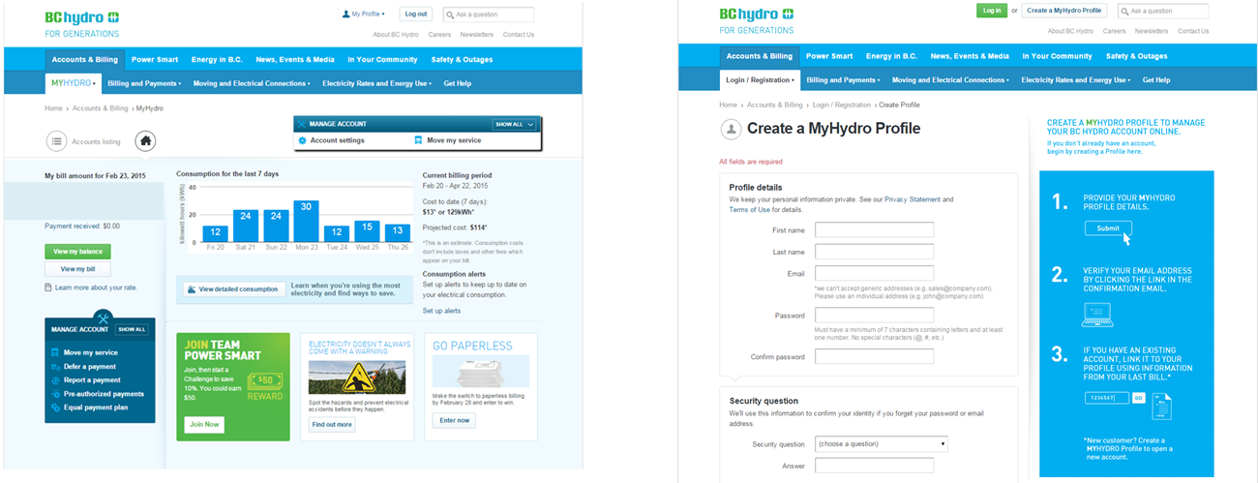
Using My Hydro
Notes:
With My Hydro, you can log on and see your energy usage in real time. This is really helpful if you’re not sure where you’re using electricity.
If your home is empty all day and you have spikes in your usage during that time, maybe you have baseboard heaters on (and set too high). This can help you figure out where you’re using your energy.
All you have to do is create a profile (it’s free).
It’s also a great place to find tips and to learn about rebates and other programs that might be available to you.

Slide 11
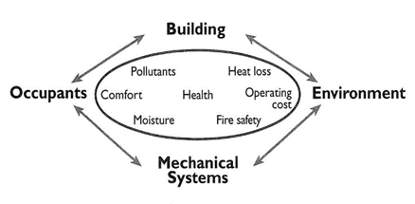
Factors Affecting Energy Efficiency
Construction
  Building code standards
  Installation and inspection procedures
Maintenance
  Materials procurement
  Procedures
Energy awareness
  Knowledge
  Behaviours
Notes:
There are 3 main contributors to energy consumption:
Construction
-to what level of building code standard we decide to build to which essentially describes how well our homes are designed, built and what materials are used
-level of professionalism in installation and inspection procedures
Maintenance
-how we keep our homes in good shape (or not)
-what materials and methods we’re using for maintenance
and Behaviour
-what we know about how to reduce our consumption
-if we actually do it

Slide 12
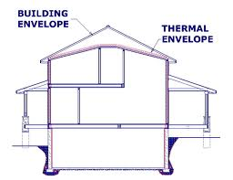
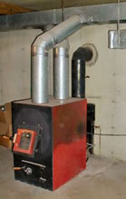
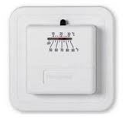
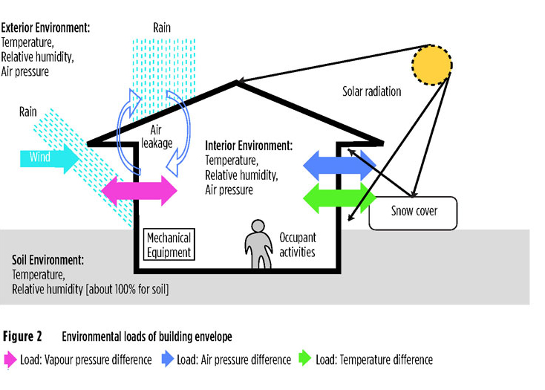
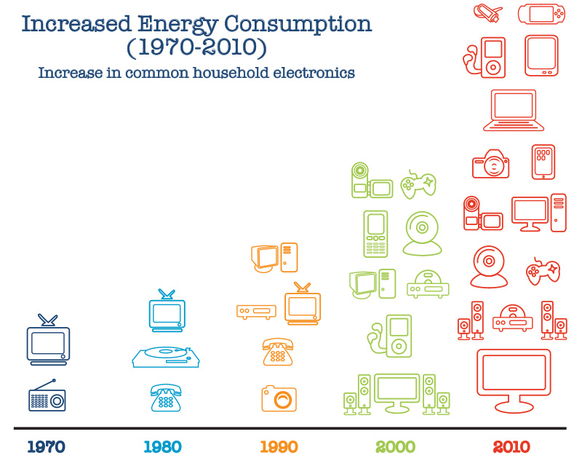
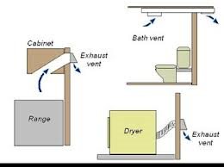
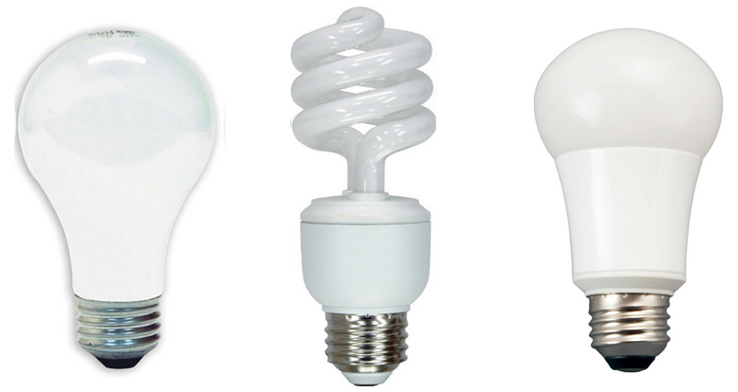
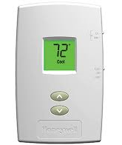
Home Structure and Components
Building envelope
  Moisture and ventilation
Heating systems
  Controls
Lighting
Appliances and
plug loads
Notes:
Our Home Structure and Components help determine out energy usage:
The Building Envelope is our walls, floors and roofs – everything that keeps weather out and keeps warmth in. We also want to consider the movement of moisture in our homes, particularly when we start to improve how airtight they are. When homes are sealed really well, a good ventilation system needs to be in place to move air, and remove excess moisture from showering, cooking, etc.
How we use heating system controls (thermostats) also makes a big impact: using old analog thermostats or dials on baseboard heaters can be very inefficient, and installing programmable thermostats that regulate temperature better can have a big impact on bills.
The light bulbs we choose make a difference too, and can really add up depending on how many lights we have in our home. LED bulbs are the most efficient, compared to old incandescent ones, and provide a lot nicer light than CFL bulbs.
Finally, since the 1970s, the number of appliances we have in our homes has changed a lot. It isn’t uncommon for one household to have multiple TVs, computers and all sorts of gadgets plugged in and running which really increases the load on our homes.

Slide 13

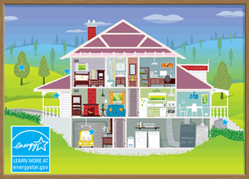

Benefits of Energy Efficient Practices
Cost savings
  Lower utility bills for all residents to keep more money in the community for other programs
  Lower maintenance costs
  Increasing lifespan of current and new housing stock
Home comfort
  Reduced drafts and hot/cold spots
Health impacts
  Improved ventilation and insulation reduces occurrence of mold
  Safer homes, especially for the young and Elders
Lower impact on the land
  Reduced greenhouse gas emissions
  Contribute towards lower provincial energy use and
  potentially eliminate need for new energy generation locations
Notes:
Even though we’ve been talking a lot about cost savings, there are lots of other benefits that are really important that come with energy efficiency practices.
Discuss the list of benefits in an interactive way, focusing particularly on aspects that the community has identified as important to them (if having a lower environment impact is very important, for example).

Slide 14
Business Case for Energy Efficiency Practices in <insert community>
Here are your current annual energy costs, by fuel type:
  <Insert approximate current spending on electricity by band>
  <Insert approximate current spending on natural gas by band>
An energy efficiency program and upgrades in a northern interior community yielded a 37% reduction in energy costs
A conservative energy reduction of 25% could mean:
  <insert> annual electricity savings
  <insert> annual natural gas savings
for both residents and the community – freeing up money for other priorities
Notes:
If known and disclosed, you can share the typical annual costs of different energy sources with Chief and Council. The savings realized in a pilot project in the northern interior saved an average of 37% on electricity, and so with even a conservative reduction of 20-30%, your community could be looking at savings of $_____/year which frees up funds for other community priorities, and reduces the financial burden on residents.

Slide 15
Energy Efficiency
Policies and Procedures
Energy efficiency policies can be incorporated into current Housing Policy documents, in areas of:
  Administration
  Maintenance
    Procurement processes and quality of materials
  Construction
    Contractor qualifications, lifecycle analysis of materials, Building Code requirements for BC
Notes:
Energy efficiency can be incorporated into:
Administration – alternative funding opportunities
Maintenance – better defined rental and ownership responsibilities, guidelines around procurement and quality of materials
Construction - hiring requirements for contractors or consultants, lifecycle analysis of products and materials to feed business case justifications, choice of building code standard to adhere to

Slide 16
Energy Efficiency
Policies and Procedures
There are energy and non-energy benefits of having a Housing Policy that incorporates energy efficiency policy
  Improved maintenance procedures, practices, and materials
    e.g., standardized equipment purchases and suppliers, preventative maintenance
  Higher new construction standards
    e.g., procedures for ensuring compliance with BC Building Code Standards, or better
  Clear administrative responsibility for overseeing Housing Policy and related activities
Notes:
Some benefits include:
-improved practices and materials, which reduces workload strain and moves maintenance from a more reactive to proactive system
-stronger construction standards for both building and inspection ensures homes are built properly, and able to be maintained properly, which fulfills two of the three key factors in energy efficiency that were discussed
-defined responsibility for overseeing housing and energy related matters

Slide 17
Energy Efficiency Policy Self Assessment Tool
Policy Areas | No EE Policy |  |  |  | Highly Developed EE Policy
Policy development and use | No guidelines around EE | The Band has an unwritten set of guidelines around EE | The Band has an EE policy but the policy has not been formally adopted by the Leadership | The Band has a formal EE policy the policy but no active ongoing commitment from the Leadership | The Band has an EE policy action plan which is regularly reviewed and has active commitment of the Leadership
Organization | No delegation or responsibility for managing energy use by the community | Informal and loose EE requirements with the Band mainly focused on energy supply | There is some delegation of responsibility for EE but line management and authority is unclear | There is a clear line for accountability by the Band administration around the overall consumption of energy and responsibility for the efficient use of energy | The EE policy is fully integrated into Band administration structure with clear accountability for the community’s overall energy consumption
Investment | No investment in improving energy efficiency | Only low or medium cost measures are considered. Other measures are only considered when required by funders | Low or medium cost measures for EE are routinely considered when short payback periods are achievable | Equal appraisal criteria used for energy as for other cost reduction projects | Resources routinely committed to EE in support of Band objectives
Performance Measurement | No measurement or records of energy consumption completed | Check of energy related invoices only | Monthly monitoring by fuel type | Scheduled energy performance measurement for each process, unit or site | Comprehensive energy performance measurement against targets with effective reporting to Leadership and community
Staff Training | Informal EE organization. Main focus on ensuring secure energy supply | Technical staff occasionally attend specialist courses | Ad-hoc training for selected staff, as required | Energy training targeted at major users following training needs analysis | Comprehensive staff training tailored to identify EE opportunities and to develop business cases which can be acted upon
Communications | No communications or promotion of EE issues | Ad-hoc informal contacts used to promote EE | Some use of organization communication mechanisms to promote EE | Regular staff briefings, performance reports and EE promotion | Extensive communication of energy issues and impacts within the Band administration and community
Notes:
This tool was developed to assist communities in assessing where they currently are in terms of energy policy, and to highlight the steps in getting to where they would like to end up. The choice of how developed to make any one area of policy lies with your community, and the series of steps is just a guideline to visualize how you can get there.

Slide 18
New Construction Standards Options
 | Current BC Building Code | Energuide 80 | R-2000 | Energy Star®
Requirements | Insulation, space and water heating equipment designed and installed in accordance with 9.36 of the BC Building Code | Use energy efficient windows, heat recovery ventilation or improved insulation to meet energy target High efficiency space and water heating appliances | Heat recovery ventilation required Mandatory air tightness levels Increased insulation of building enclosure to meet Energuide 80 performance level | Use Energy Star® windows Use Energy Star® appliances Heat recovery ventilation required Increased insulation of building enclosure above code minimum Mandatory air tightness levels High efficiency space and water heating appliances
Costs | Standard | Additional $ 8,000 - $12,000 (or higher) per house | Additional $ 8,000 - $12,000 (or higher) per house | Additional $10,000 - $15,000 (or higher) per house
Potential Energy Savings | Baseline | Varies | 20% | 20%
Benefits | Cost effective house and construction cost | Reduced operating costs Improved indoor air quality Reduced noise Improved humidity control | Reduced operating costs Improved indoor air quality Reduced noise Improved humidity control Built by certified R-2000 contractor | Reduced operating costs Improved indoor air quality Reduced noise Improved humidity control
Drawbacks | Unquantified higher operating costs reflecting lower air sealing and other construction standards | Higher initial cost Investment in additional training for maintenance persons on new components | Higher initial cost Investment in additional training for maintenance persons on new components | Higher initial cost Investment in additional training for maintenance persons on new components
Notes:
In terms of new construction, these are several of the building code standard options available to you. The current BC building code likely resembles most closely the standard you’re currently aiming for, and so the cost for that would be a baseline cost – the typical cost in (insert community) for a new home. You can expect additional costs to meet more stringent building practices, with various benefits and drawbacks to each standard. The choice to build to any one standard should consider several factors, such as cost, potential energy savings, potential home quality benefits, and future maintenance requirements which may involve staff training upgrades.

Slide 19


Policy…the tip of the iceberg!
Policy needs to reflect
entire situation and community
A holistic EE policy considers:
  New construction
  Maintenance
  Capacity building
  Responsibilities of both residents and Council
Building envelope, space heating, water heating, appliances, lighting
Notes:
Policy fills a necessary role, both with housing in general but also in order to implement energy efficiency practices well. However, the policy is just one part of the puzzle, and in order to be effective it needs to accurately reflect all aspects of your community, both now and in the future. In building an energy efficiency policy, you should include considerations not only for new construction and maintenance, but also how the policy could build capacity through training and employment and how responsibilities for energy reduction actions might be divided between community members and Council.

Slide 20
Involving the Community
Energy Champion
  Community-based leader who works to facilitate energy project, shares energy knowledge, and acts as energy contact for other residents
Green Team
  All-ages community team supporting other members in reducing energy use
Social media or other platform for sharing tips, knowledge, and information
Set community-wide challenge and goals
Notes:
Discuss ways to drive momentum within the community, and start a discussion on how to get this community involved and interested from those in attendance.

Slide 21
Questions and Discussion
<insert community logo and/or picture>

